Slide 1
Project Proposal … …
Team JAQEN
Nicolas Morant, Jack Tsu
DGMD E-14 - HARVARD UNIVERSITY – FALL 2021

Slide 2
1. introduction

Slide 3

1.1 Goal of the project
…

Slide 4
1.2 Level of Autonomy
…
Target Market:
…

Slide 5
1.3 Description

Slide 6
2. Related Work

Slide 7

2.1 Inspiration
https://github.com/...

Slide 8
3. Team Organization

Slide 9
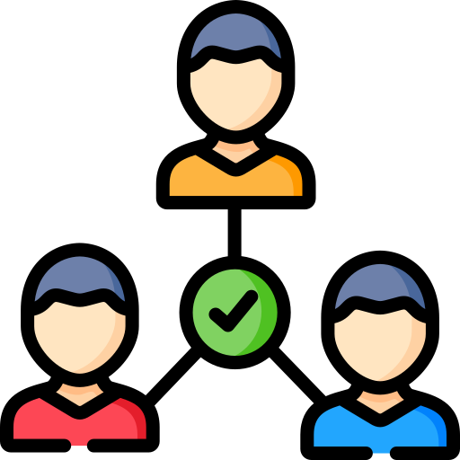
3.1 Team Members and roles
Nicolas Morant:
Object Detection
Huayu (Jack) Tsu:
Facial Recognition

Slide 10
4. Software and developing tools

Slide 11



4.1 Software

Slide 12


4.2 Laptop/Desktop Setup
Desktop computers
Recommended requirements:
…

Slide 13
4.3 Hardware needeD
Raspberry Pi Zero W
…

Slide 14
5. List of Milestones

Slide 15

5.1 Outline and schedule
Week | Date | Milestone
3
4
5
6
7
8
9
10
11
12
13
14
15

Slide 16
5.2 Phases
ABC
Tasks:
…
…
…
Integration
Tasks:
Fuse all features from phase 1 & 2
PHASE 1
PHASE 2
PHASE 3
BONUS PHASE
ABC
Tasks:
…
…
…
…
Tasks:
…
…

Slide 17
6. Team meeting Schedule

Slide 18

6. Team meeting Schedule
More meetings will be added as needed throughout the semester.

Slide 19
…
COMING SOON
TEAM JAQEN

